Slide 1
C++ with Cevelop
Vectors

Slide 2
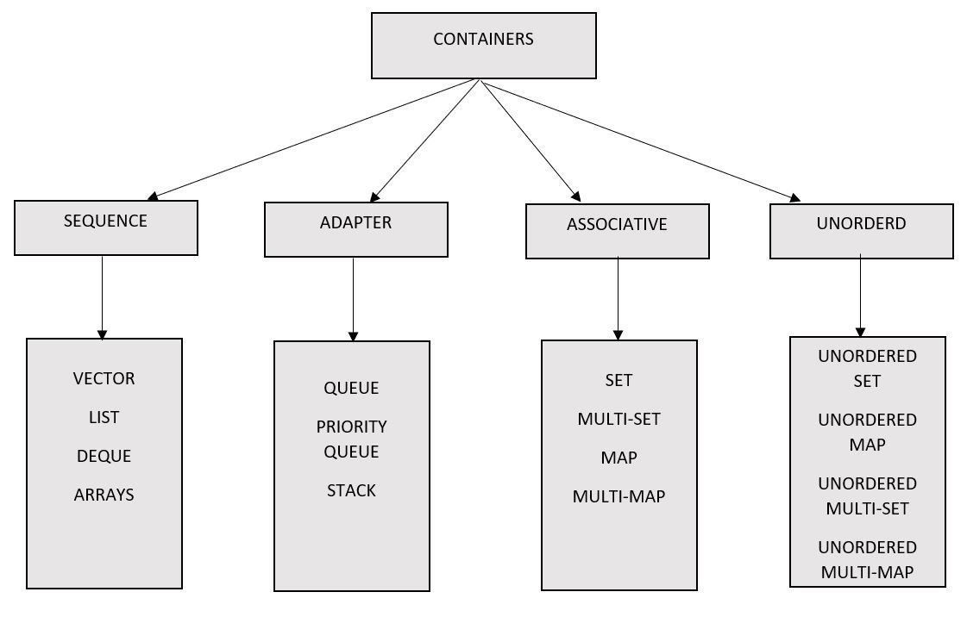
Containers
Stores a collection of object that was implemented as class templates

Slide 3
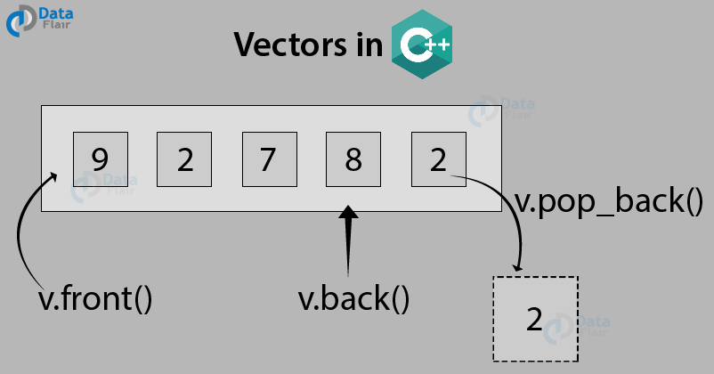
Vectors
Similar to array but array size can be adjusted
Part of the STL library

Slide 4
How to Declare Vectors
Implement the Vector Library (#include <vector>)
Make sure the using namespace std is implemented before int main()
In main type in
vector <[data type]> [name]

Slide 5
How to Assign Vector
There are many ways to put values into vector, but I typically do
[vector name].pushback([values you want to assign based on datatype])

